Slide 1
18PYB103J
SEMICONDUCTOR PHYSICS
MODULE 4
LECTURE 1 – CONCEPT OF ELECTRICAL MEASUREMENTS, TWO PROBE METHOD

Slide 2
CONCEPT OF ELECTRICAL CONDUCTIVITY
Electrical Measurements:
Measurements of electrical quantities, such as voltage, impedance, current, AC frequency and phase, power, electric energy, electric charge, inductance, and capacitance
Electrical measurements are among the most widely performed types of measurement.
The resistivity measurements can be studied by different techniques

Slide 3
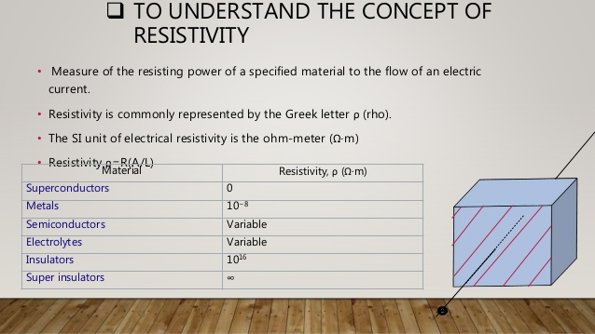
Concept of Resistivity

Slide 4
CONCEPT OF ELECTRICAL CONDUCTIVITY
Ohm's law: If physical conditions such as temperature, stress, strain remains unchanged in the materials, then potential difference (V) across two ends of a conductor is proportional to current (I) flowing through a conductor, i.e.,
V ∝ I (or)
V = I R
The constant of proportionality, R, is called resistance of the material.

Slide 5
CONCEPT OF ELECTRICAL RESISTIVITY
Resistivity:
At a given constant temperature, the resistance R of the conductor is (i) proportional to its length (L) and (ii) inversely proportional to its area of cross-section (A), i.e.,
R ∝ L / A (or) R = ρ L / A
Resistivity is important for devices because it contributes to the device series resistance, capacitance, threshold voltage, hot carrier degradation of MOS devices, latch up of CMOS circuits, and other parameters.

Slide 6
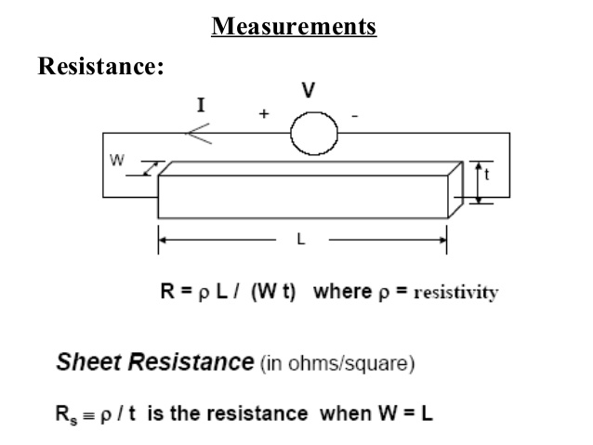
RESISTIVITY MEASUREMENTS

Slide 7
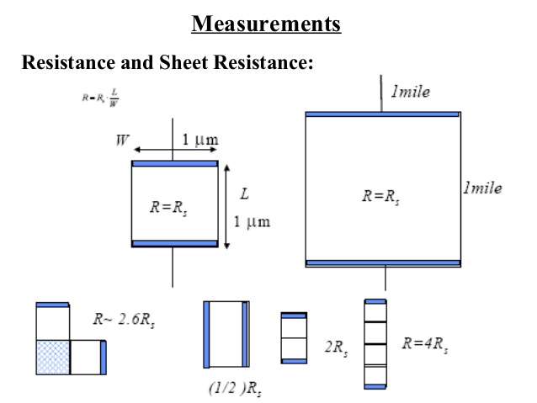
RESISTANCE AND SHEET RESISTANCE

Slide 8
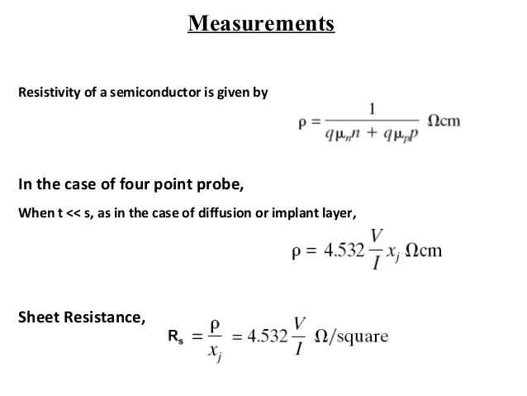
RESISTIVITY MEASUREMENTS

Slide 9
METHODS FOR MEASURING RESISTANCE
Two general methods involved for measuring the resistance of the materials are:
(i) Two point probe method
(ii) Four point probe method
linear method & Vander pauw method

Slide 10
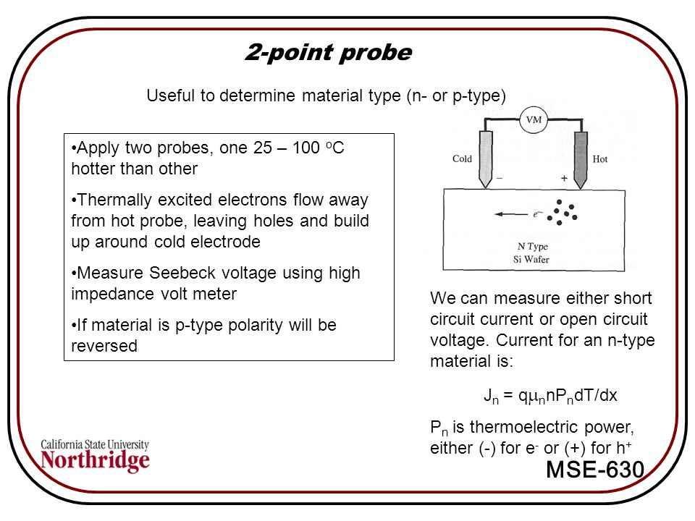
TWO PROBE METHOD

Slide 11
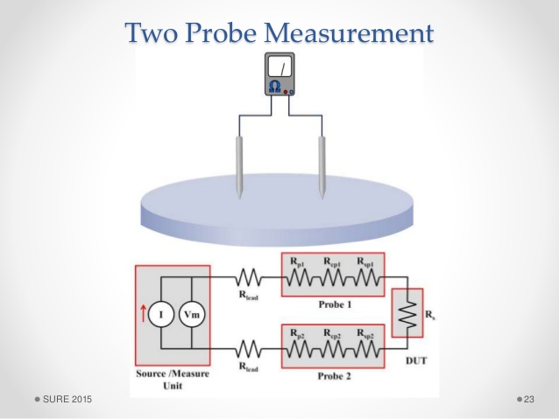
TWO PROBE METHOD

Slide 12
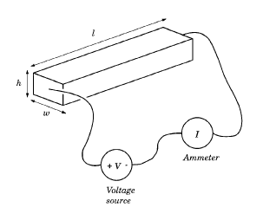

TWO PROBE METHOD
The resistivity of the bar can be measured by measuring voltage drop across the wire due to passage of known current supplied by the battery E through the probes 1 and 2. The potential difference (V) between the two contacts at the ends of the bar can be measured by a voltmeter. Therefore, the resistivity of the wire is, i.e.,

Slide 13
TWO PROBE METHOD
While the two-probe method is a simple and advantageous method for measuring resistance above 1Ω directly, this method suffers from certain issues.
Two-probe method:
Error due to contact resistance of the measuring leads

Slide 14
TWO PROBE METHOD
Heating of the leads during soldering may inject additional impurities in materials such as semiconductors and thereby affecting the intrinsic electrical resistivity largely.
In order to overcome the above problems, four-probe method is widely proposed.

Slide 15


